Slide 1


MONGODB
Why MongoDB icon is a leaf? Our founders believe that coding should be natural, and so should using a database. They want the experience of using MongoDB to be simple and natural.

Slide 2
MongoDB
Document database
NoSQL database
Everything is around JSON objects

Slide 3
Install MongoDB into Window
All the demos in the next attached to mongo-demo folder.

Slide 4
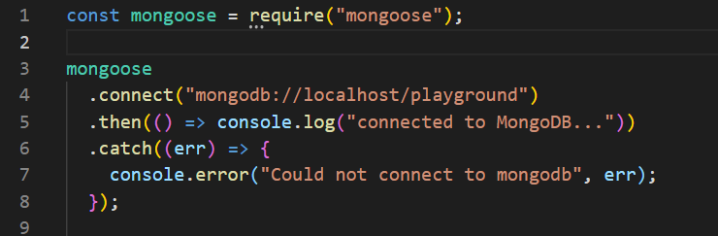

Install mongoose and open connection
Mongoose is a simple wrapper API over mongo dB

Slide 5
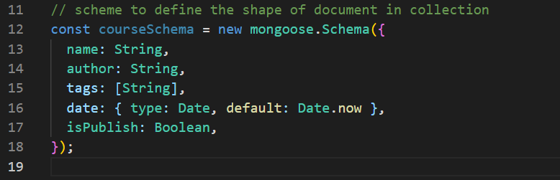
Schemas
scheme to define the shape of document in collection
Date have a default value. For all the attributes we can set default values

Slide 6
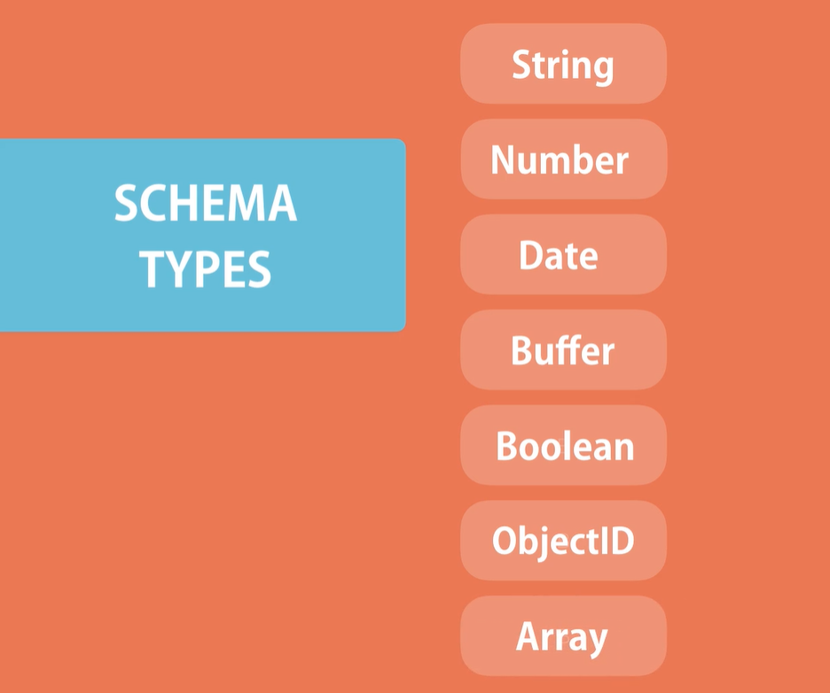

Slide 7
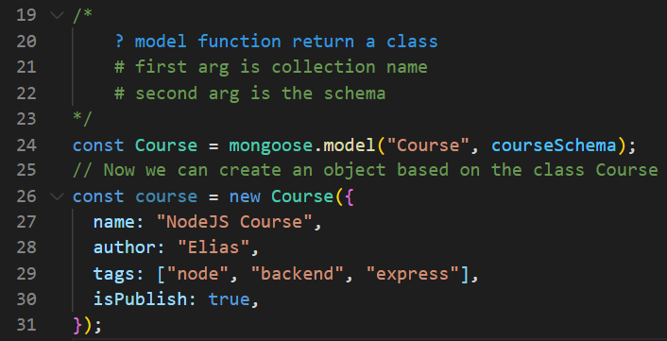
Models
We need to compile our schema, into model. In order to create and get instances based on models from Mongo dB

Slide 8
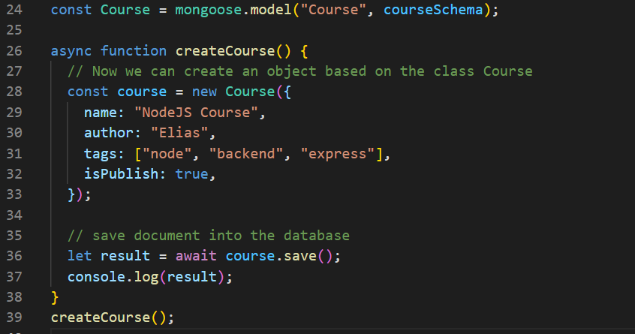
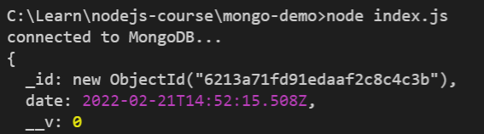
Saving a Document

Slide 9
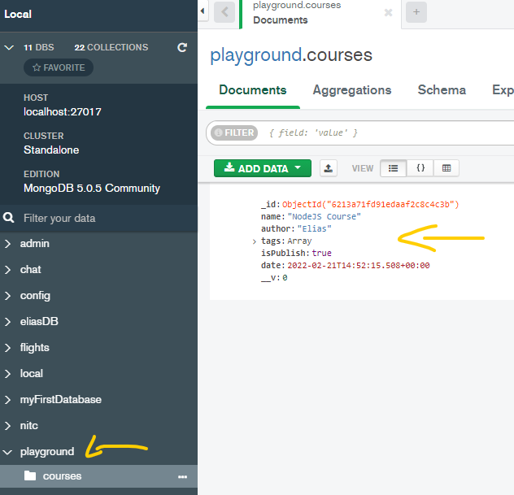
Check data using MongoDB Compass

Slide 10
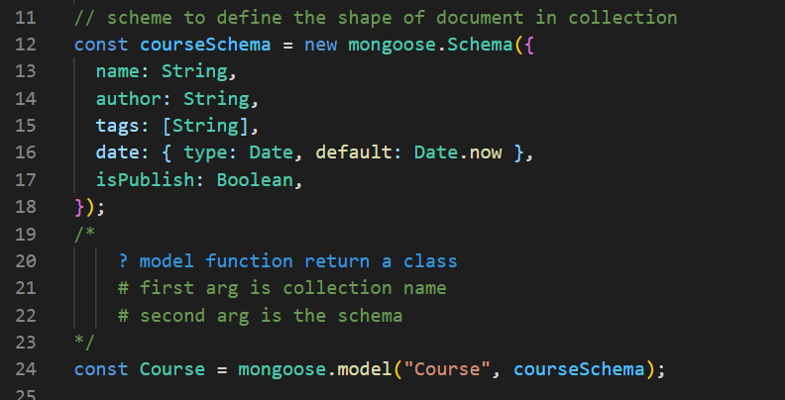
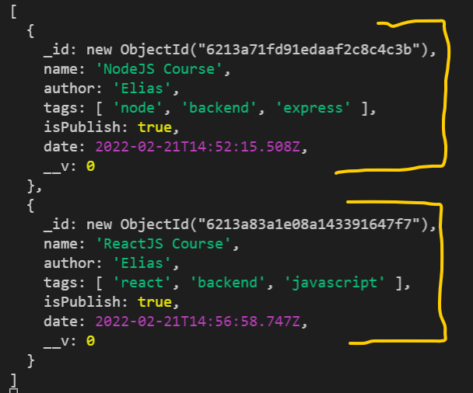
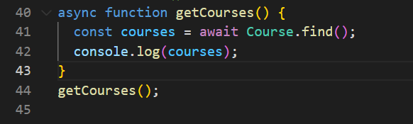
Querying Documents

Slide 11
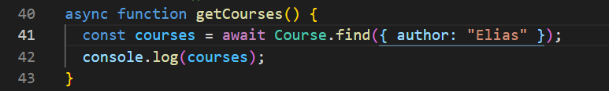
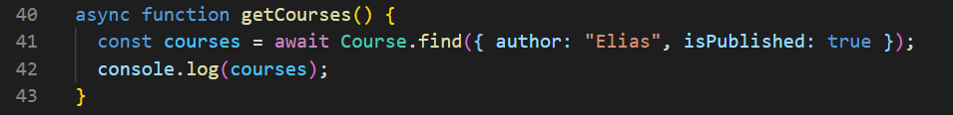
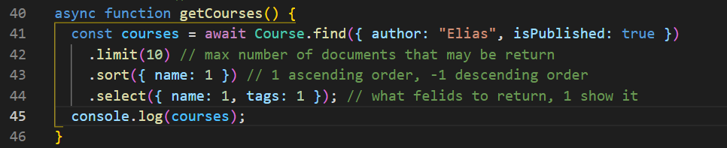
Querying Documents – with filter

Slide 12
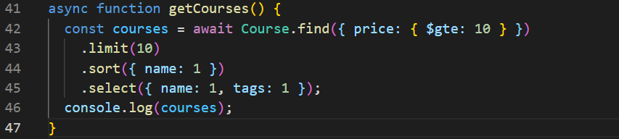
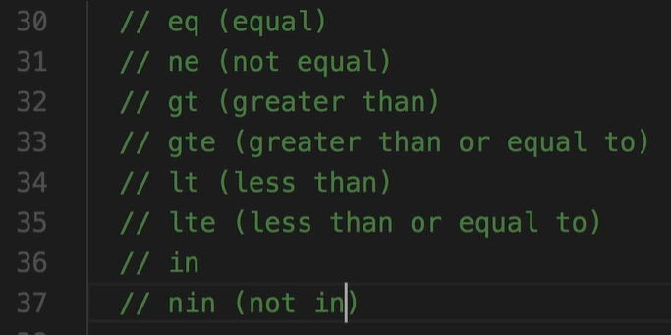
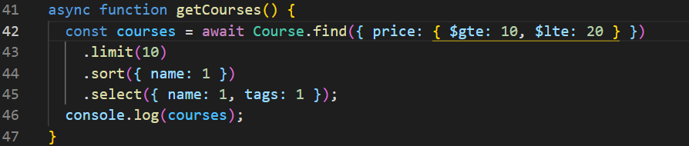
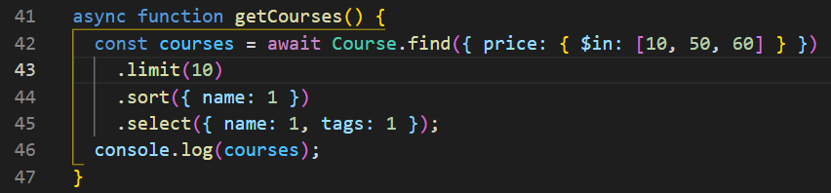
Comparison Query Operators
Greater then or equal to 10$
Operators
Greater than 10$ and less then 20$
Courses price is 10$ or 50$ or 60$

Slide 13
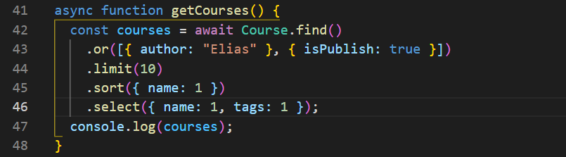
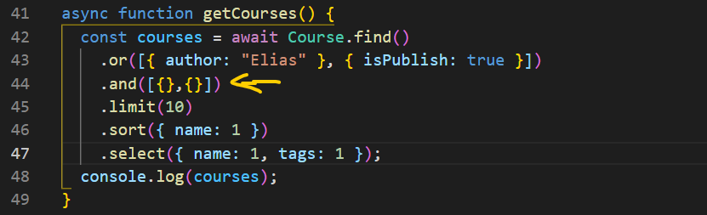
Logical Query Operators (or ,and)
Get courses that author is Elias or isPublish equal to true
And operator the same

Slide 14
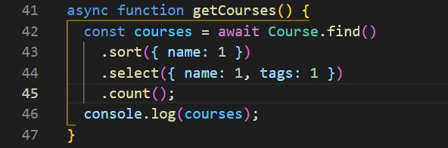

Counting

Slide 15
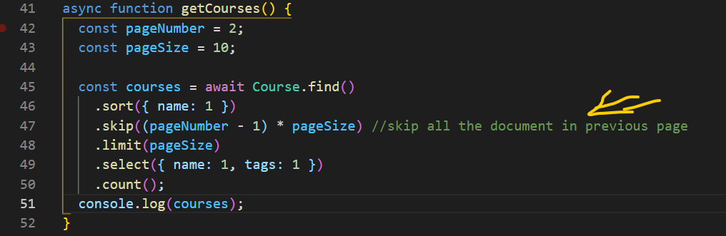
Pagination
We use the skip method in order to implement pagination
Int the real-world example when u implement an API
Using express u going to have URL like that:
/api/courses?pageNumber=2&pageSize=10

Slide 16
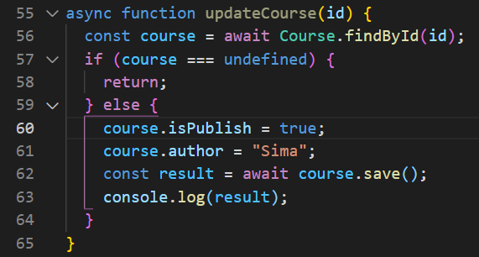
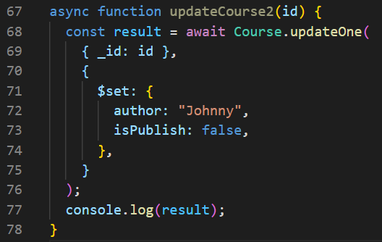
Updating a Document- Query First
There is two ways to update document in Mongo dB
1) Query first
findById() -> Modify its properties -> save()
2) Update first
update directly (without retrieve the document) , optionally get the updated document.
Query first
Update first

